Slide 1
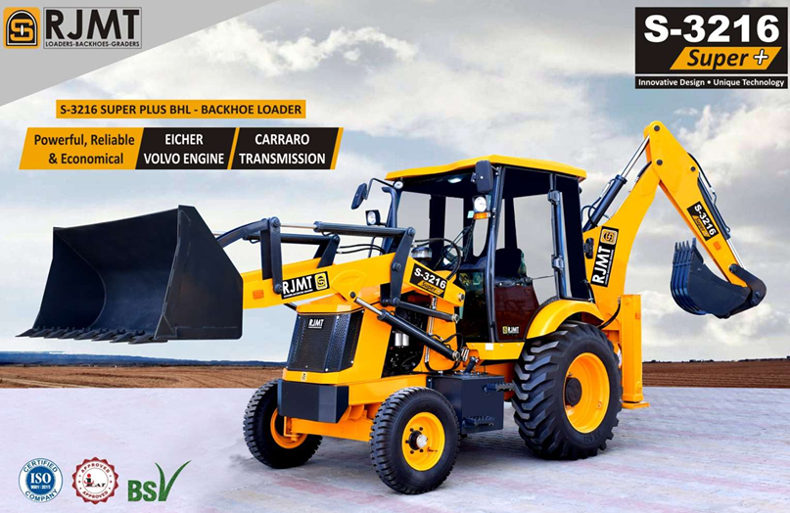
All new CEV -5 S-3216 SUPER PLUS BACKHOE AND LOADER
Compliance various
International safety standards

Slide 2

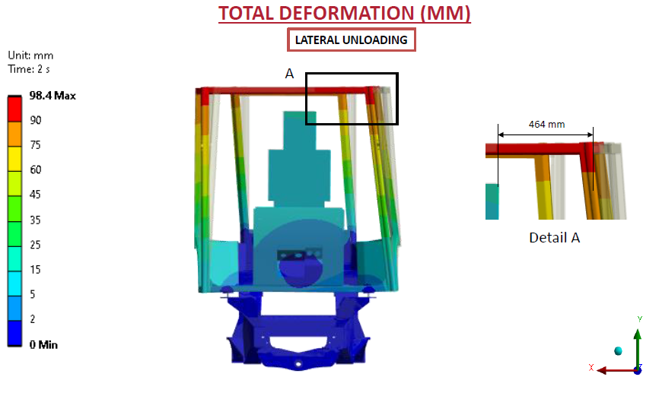
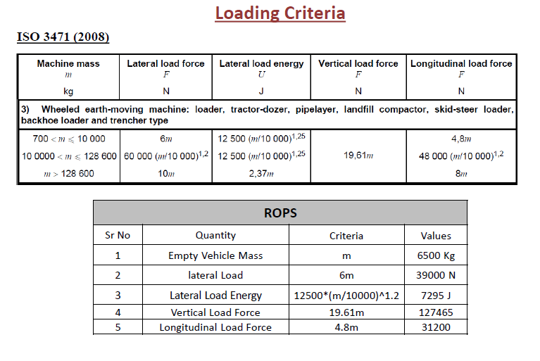
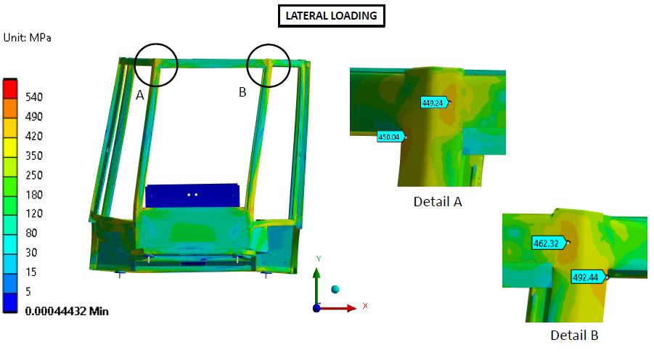
NEW S-3216 SUPER CEV-5 - SAFETY COMPLIANCES
New CEV 5 modified Backhoe Cabin S3216 Super Plus -
Compliance of Roll over protection structure as per ISO 3471 (2008) - ROPS
Structure Protects Operator under roll over Situation.

Slide 3
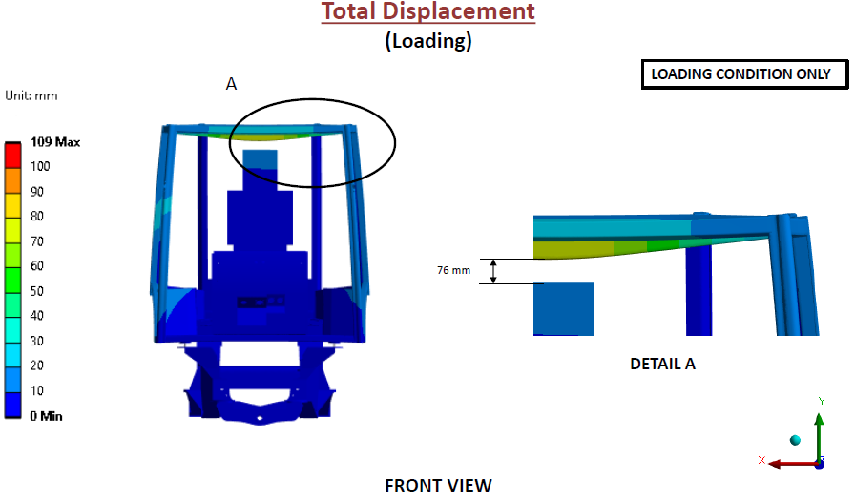
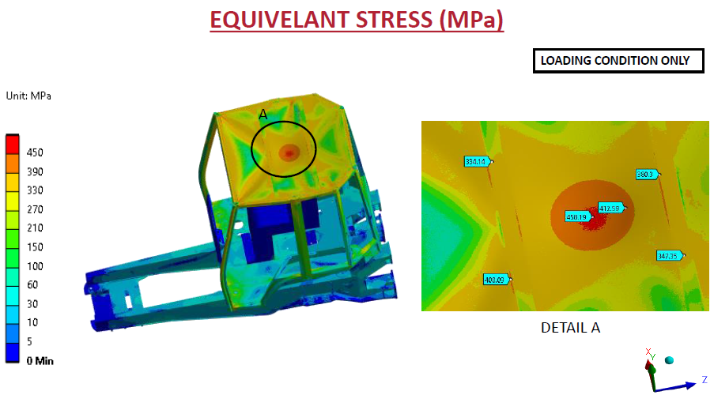
NEW S-3216 SUPER CEV-5 - SAFETY COMPLIANCES
New CEV 5 modified Backhoe Cabin S3216 Super Plus -
Compliance of Falling object protection structure as per
ISO 3449: (2005) - FOPS
Total energy of 11600 J is transferred to cabin by imparting the load on cabin top structure as per the guidelines stated in ISO 3449-2005.

Slide 4
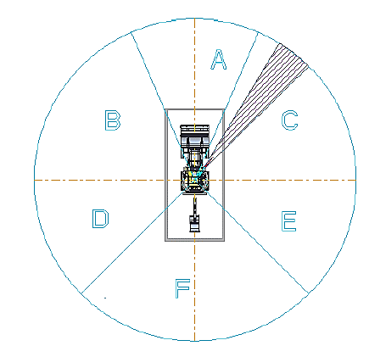
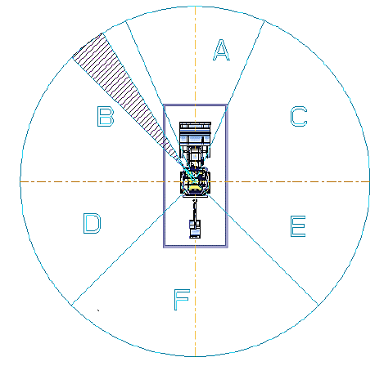
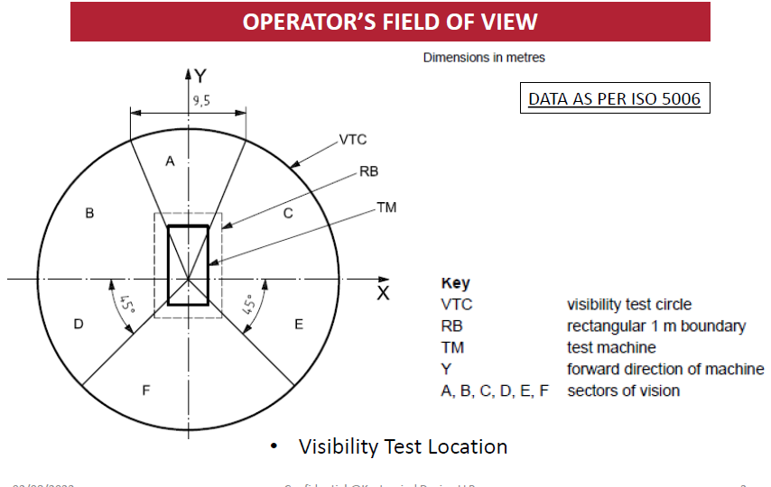
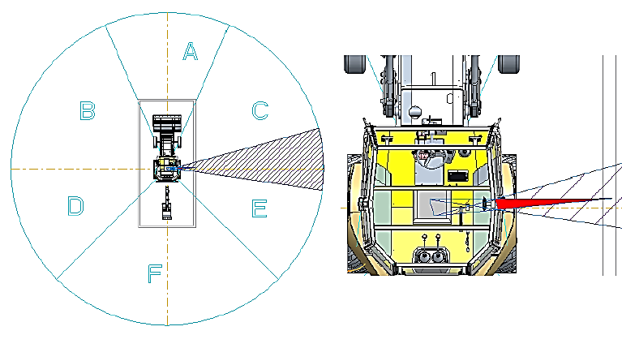
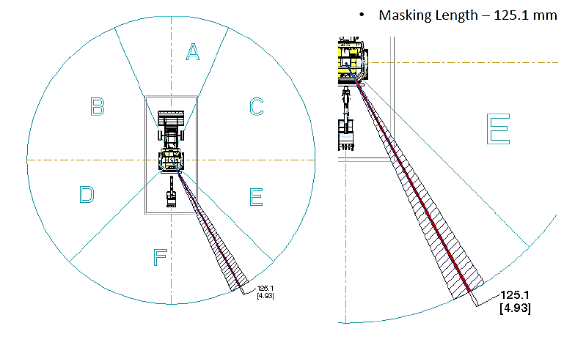
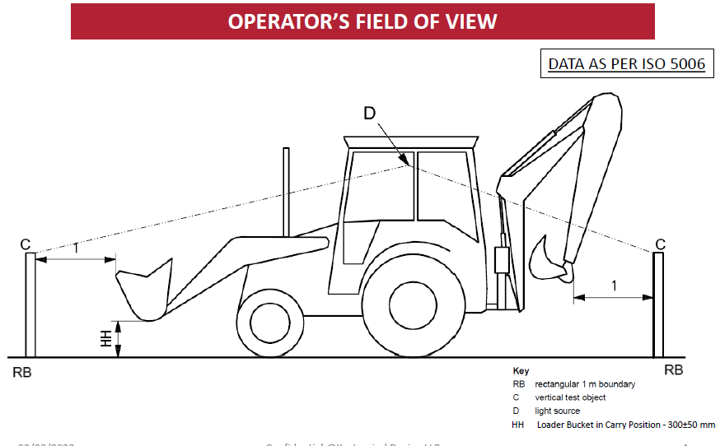
NEW S-3216 SUPER CEV-5 - SAFETY COMPLIANCES
New CEV 5 modified Backhoe Cabin S3216 Super Plus -
Compliance of Operator Field on view as per ISO 5006 : 2017
Operator has better field on view , No masking area come in all A,B,C,D,E,F Sectors and in inner rectangular boundaries.

Slide 5
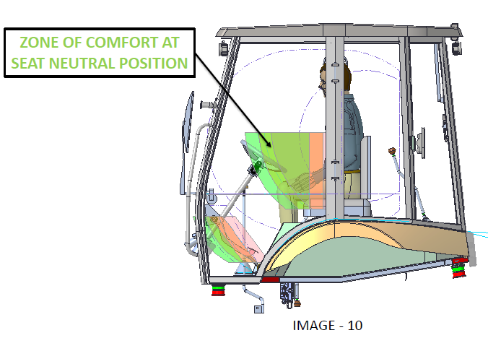
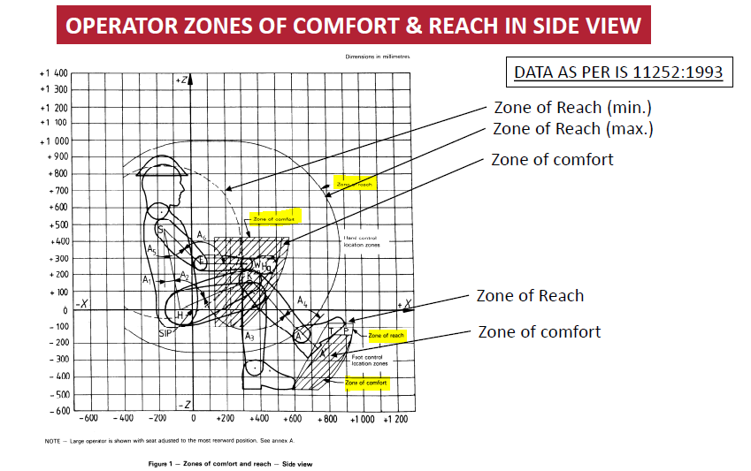
NEW S-3216 SUPER CEV-5 - SAFETY COMPLIANCES
New CEV 5 modified Backhoe Cabin S3216 Super Plus -
Compliance of Zones of comfort and Reach for controls for Operator as per ISO 6682 : 1986 / IS 11252:1993
All primary and secondary operator controls comes under the zone or comfort and Reach – This will give better comfort to operator and long working hrs without fatigue.
This machine match the comfort to all European and American cabin’s comfort level.

Slide 6
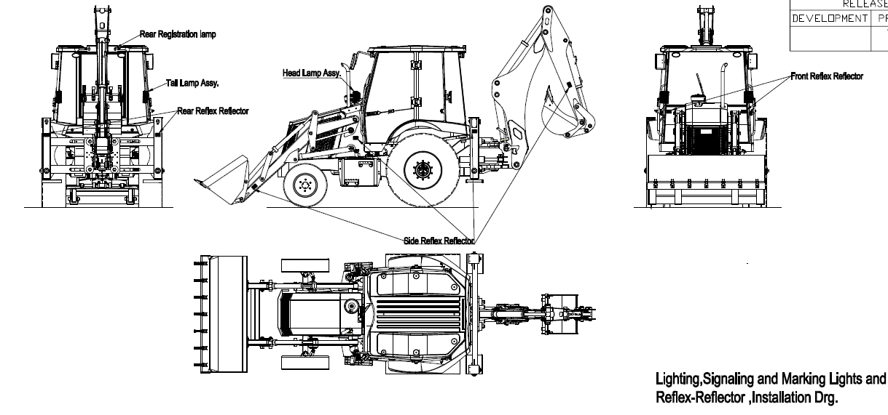
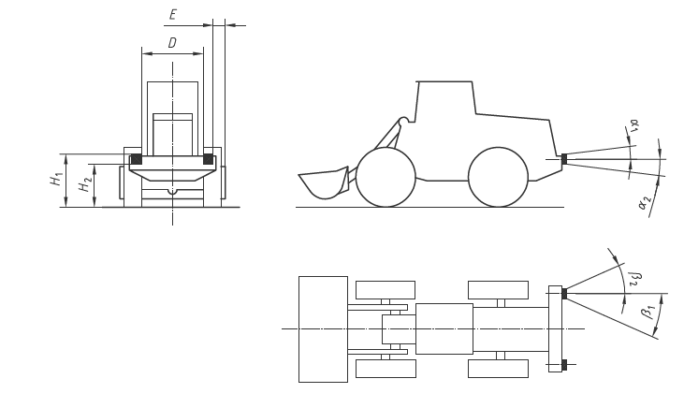
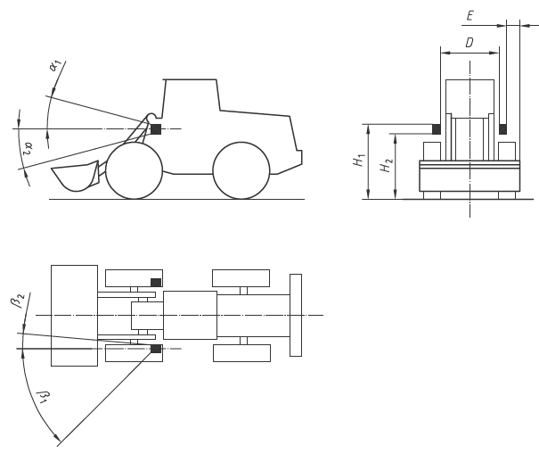
NEW S-3216 SUPER CEV-5 - SAFETY COMPLIANCES
New CEV 5 S3216 Super Plus -
Compliance of Installation of Lighting and light signalling devices as per ISO 12509 : 2004
All light ,signalling and reflex reflectors are installed in the machine as per IS0 12509:2005
This give better safety to machine ,operator and surroundings.
Now this machine lighting installation is equal to European and American machines.

Slide 7
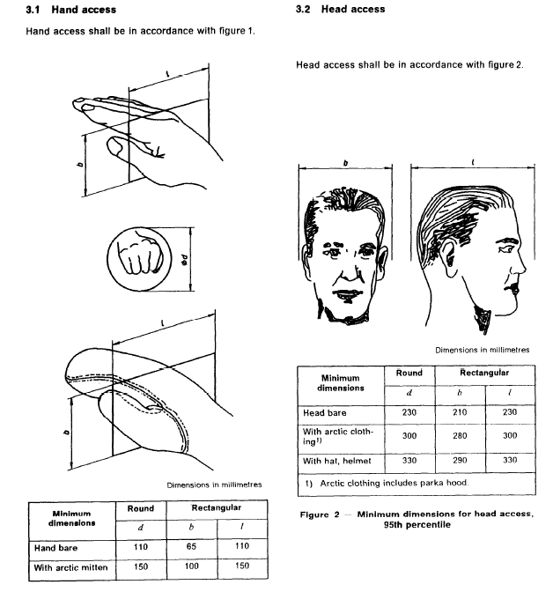
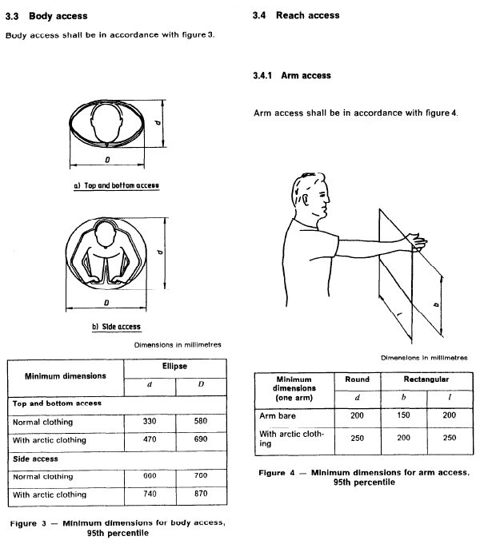
NEW S-3216 SUPER CEV-5 - SAFETY COMPLIANCES
New CEV 5 S3216 Super Plus -
Compliance of Minimum access dimension as per ISO 2860 : 1992
This International Standard specifies the minimum access openings on earth-moving machinery as defined in IS0 6165 for a) hand access, b) head access, c) body access, d). arm access, e) two-handed access. Access openings provided on equipment and machinery for purposes of inspection , adjustment and maintenance have sufficient
dimensions for the intended function by personnel in the field or shop.

Slide 8
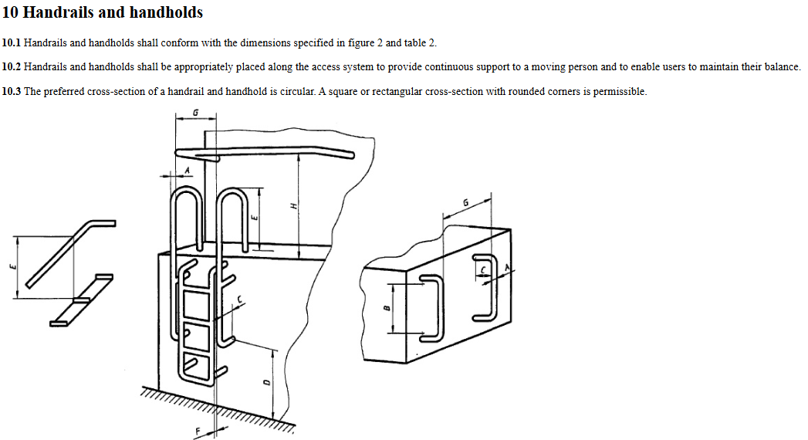
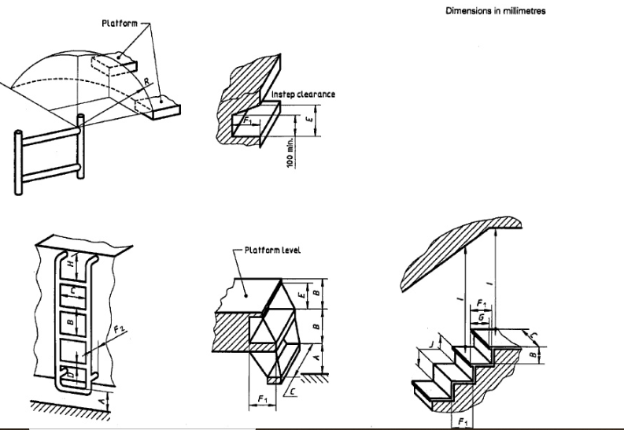
NEW S-3216 SUPER CEV-5 - SAFETY COMPLIANCES
New CEV 5 S3216 Super Plus -
Compliance of Access system for steps, Primary access , alternate exit and opening , maintenance opening , handrail and handholds as per ISO 2867 : 2011
This part of ISO 11660 specifies criteria for steps, stairways, ladders, walkways, platforms, handrails, handholds, guardrails and entrance openings which permit access to and from operator, inspection or maintenance platforms .It also presents requirements for guards and restraints as related to moving parts.

Slide 9
NEW S-3216 SUPER CEV-5 - SAFETY COMPLIANCES
New CEV 5 S3216 Super Plus -
Compliance of Gaurds- Barrier Gaurds, fender, fan guard, thermal guard and hose gaurds as per ISO 3457:2003
Earth-moving machinery - Guards and shields -
SCOPE surfaces soiled by lubricants or by dirt or, generally speaking, from any hazards when approaching, leaving or working .This International Standard gives definitions and specifies moving about on the machine. The characteristics of different guards and shields to protect
personnel from accidental hazards which may arise during

Slide 10
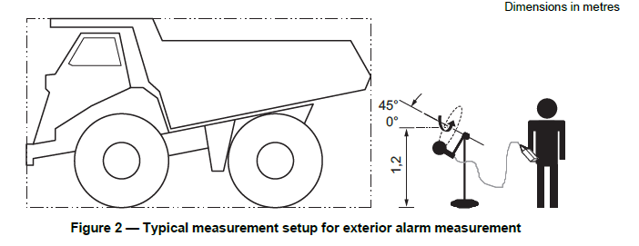
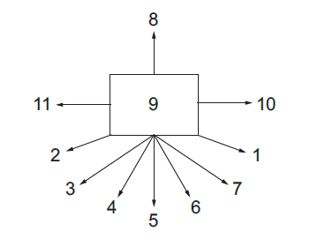
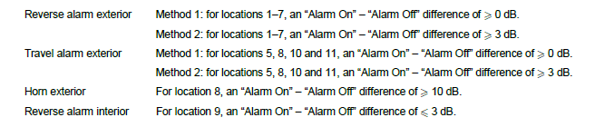
NEW S-3216 SUPER CEV-5 - SAFETY COMPLIANCES
New CEV 5 S3216 Super Plus -
Compliance of Machine mounted audible travel alarm and forward horn as per ISO 9533-2010
The sound output performance and alarm activation requirements of audible travel alarms
and forward horns mounted on earth-moving machinery, as defined in ISO 6165, for operation
on work sites and travelling on public roads.
This give safety and alertness to surrounding persons.

Slide 11
NEW S-3216 SUPER CEV-5 - SAFETY COMPLIANCES
New CEV 5 S3216 Super Plus CABIN SEAT -
Compliance of
Seat index point as per ISO 11113:1999
Evaluation of operator seat vibration for suspended seat as per ISO 7096:200
SEAT BELTS AND SEAT BELT ANCHORAGES – PERFORMANCE REQUIREMENTS AND TEST as per ISO 6683:2005
OPERATOR SEAT – DIMENSIONS AND REQUIREMENTS STANDARD NO. IS/ISO 11112: 1995
Operator seat compliance above standard which ensure safety, productivity and comfort of the operator.

Slide 12
NEW S-3216 SUPER CEV-5 - SAFETY COMPLIANCES
New CEV 5 S3216 Super Plus -
Compliance of SOUND POWER LEVEL — STATIONARY TEST CONDITIONS as per ISO – 6393:2008
New CEV 5 S3216 Super Plus -
Compliance of SOUND POWER LEVEL — DYNAMIC TEST CONDITIONS as per ISO – 6395:2008
Sound / noise level emit during stationery and dynamic working to the surrounding is as per above standards.
Low sound emission give better working environment and safety to operator and surrounding co-worker and staff.

Slide 13
NEW S-3216 SUPER CEV-5 - SAFETY COMPLIANCES
New CEV 5 S3216 Super Plus -
Compliance of SOUND POWER LEVEL at operator position — STATIONARY TEST CONDITIONS as per ISO – 6394:2008
New CEV 5 S3216 Super Plus -
Compliance of SOUND POWER LEVEL at operator position — DYNAMIC TEST CONDITIONS as per ISO – 6396:2008
Sound / noise level emit during stationery and dynamic working at the operator level is as per above standards.
Low sound emission give better working environment and safety to operator and other surrounding co-worker and staff.
Low noise at operator position improve work environment and
Improve productivity and long working.

Slide 14
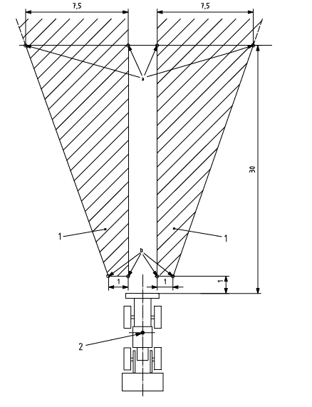
NEW S-3216 SUPER CEV-5 - SAFETY COMPLIANCES
New CEV 5 S3216 Super Plus -
Compliance of symbols for operator control as per ISO – 6405-1/2
Like any other export machines
New CEV 5 S3216 Super Plus -
Compliance of installation requirement of rear-view mirror as per ISO – 14401-1 / 2 2009

Slide 15
NEW S-3216 SUPER CEV-5 - SAFETY COMPLIANCES
New CEV 5 S3216 Super Plus -
Compliance of Electromagnetic Compatibility (EMC) of machine with internal electrical power supply as per ISO 13766-1:2018
It’s ensure no emission of broadband and narrowband electromagnetic waves from the machine.
It’s ensure the immunity of machine from broadband and narrow band electromagnetic waves.
ESD- Safety of components from Electrostatic discharge.

Slide 16
NEW S-3216 SUPER CEV-5 - SAFETY COMPLIANCES
This new machine compliance lot more safety and standards as per international standard organization like :
Steering Effort
Brakes (service and parking)
Tyres
Safety Glasses
Light, Lamps , Reflectors
CEV 5 Pollution Emission
Decals , Tell-tale
Sound Levels
ETC
Thank You

Slide 17
NEW S-3216 SUPER CEV-5 – ENGINE
Engine Highlight
Engine change from CEV 3 kirloskar to CEV 5 Volvo Eicher
Pure Mechanical engine change to Mechanical cum Electronic Engine
Torque Improve from 205nm to 235 nm
Lesser vibration
Less noise
Better fuel Efficiency
Service By RJMT
Refined and Capable

